Slide 1
R&D Committee Workshop Series:
Initial Review and Approval of Exempt Research (Part 1)
Dial in: (631) 992-3221
Access Code: 121-569-047
Slides in “Handout” Tab
Moderated by:
Soundia Duche, MA, MS
Chief, Education & Training
ORPP&E
February 19, 2020

Slide 2
Introductions
Dial in: (631) 992-3221
Access Code: 121-569-047
Slides in “Handout” Tab
Dawn Biddulph, Program Specialist, R&D/IRB Coordinator, Lexington VA Health Care System
Gregory L. Green, MPH, CIP, HRPP Manager, San Francisco VA Health Care System

Slide 3
Objectives
Dial in: (631) 992-3221
Access Code: 121-569-047
Slides in “Handout” Tab
Brief recap of what it means to be “Exempt”
Discuss roles and responsibilities of key entities involved in the initial review and approval of exempt research
Review tools for use by exempt determination officials

Slide 4
What does it mean to be Exempt?
Exempt from the Common Rule
  Generally means not subject to the requirements of the Common Rule, but it is important to note that “exempt” does not mean exempt from all of the requirements of the Common Rule
    Some of the categories of human subject studies determined to be exempt under the 2018 Requirements require limited IRB review as a condition of the exemption
As a covered entity VA is not exempt from the Privacy Rule and the Privacy Act
  HIPAA requirements apply to exempt research involving protected health information (PHI)
    PHI is defined as Individually-identifiable health information transmitted or maintained in any form or medium by a covered entity (VHA Directive 1605.01 para 3vv)

Slide 5
When Does a Study Qualify for Exemption: Exempt Categories under the 2018 Requirements
Research activities in which the only involvement of human subjects will be in one or more of the eight* categories outlined in the Common Rule (38 CFR 16.104(d)) may be exempt from the Common Rule
  *Exempt category 7 which requires obtaining Broad Consent is not implementable in the VA, thus use of this category is not feasible
All research activity(ies) must meet the requirements of the exempt categories selected
If limited IRB review is required, the IRB must determine that the limited IRB review criteria are met
Refer to handout for a list of exempt categories

Slide 6


Island Hopping:
Approving Exempt Research
Exempt Determination Official
IRB & Privacy Board
Research Office
Other subcommittees
Information System Security Officer
Privacy Officer
ACOS/
R&D
R&D Committee
COI Administrator

Slide 7
Initial Review and Approval of Exempt Research: Roles and Responsibilities
Roles and responsibilities of key entities involved in the initial review and approval of Exempt HSR
This tool can be used to identify the individual(s) and/or committee(s) at your Institution that play a role in the review and approval of human subjects research that is exempt from the Common Rule
Depending on your local processes and procedures for the review and approval of exempt research, additional columns and rows can be added to the table

Slide 8
Poll 1: Making Exempt Determinations
Who is responsible for making Exempt Determinations for your Facility?
IRB Chair and/or Members
R&D Committee Chair and/or Members
IRB Administrator and/or Research Office Staff
Other Designated Exempt Determination Official
Unknown/Not Applicable to my Role

Slide 9
Who Can Make Exempt Determinations for VA Research?
IRB Chair
Experienced IRB Member
  Past or Present
Qualified administrative staff with expertise in applying human research exempt regulations
  SOPs should define who makes exempt determinations for your institution
    Although not required, an appointment letter can be used to designate exempt determination officials
  SOPs should define required qualifications and training
An investigator may not self-certify that their study is exempt

Slide 10
IRB and R&D Committee Member Training
Exempt Determination Officials that are members of the IRB
  IRB must establish and follow written SOPs that include procedures for training and education of the IRB Chair, voting members, and alternates in human subjects protections, ethics, and regulatory requirements (VHA Directive 1200.05 para 8a(8))
Exempt Determination Officials that are members of the R&D Committee
  The Chair and voting members of the R&D Committee are required to complete two modules from ORD and Collaborative Institutional Training Initiative (CITI) on ethical principles of human research protection (VHA Directive 1200.01 para 14)
What about Exempt Determination Officials that are neither????

Slide 11
ORPP&E Recommended Training for Exempt Determination Officials
Recommended modules for new Exempt Determination Officials or those wishing to increase knowledge and expertise in applying human subjects regulations for exempt studies
www.citiprogram.org
Institutional Affiliation: VA Central Office
Select “Exempt Determination Official Training” or add the following modules to your Institution’s course in CITI.
Exempt Determination Official Training Course Modules
ID 498: History of Ethics in Human Subjects Research | ID 502: The Federal Regulations
ID 491: Defining Research with Human Subjects - SBE | ID 17916: Updates to Exemption Categories
ID 5: Records-based Research | ID 4: Social and Behavioral Research for Biomedical Researchers
ID 17917: Limited IRB Review | ID 505: Privacy and Confidentiality

Slide 12
Developing Expertise in Applying Human Subjects Exempt Regulations
Require initial and ongoing training in exempt categories and ethical conduct of human subjects research
Mentorship: Pair new exempt determination officials with more experienced reviewers
Vet determinations of new Exempt Determination Officials for a set period of time or set number of reviews

Slide 13
Resources for Exempt Determination Officials
Sample Exempt Application Form
Sample Exempt Determination Official Reviewer Form
Sample Exempt Determination Letter
Flowcharts/VISIOs for Exempt Categories

Slide 14
Exempt Determinations:
Practically Speaking
Exempt research and the Single IRB Mandate
  The Cooperative research provision/single IRB review mandate does not apply to exempt research
Overlap between exempt and expedited review categories
  Overlap exists between exempt category 2 and expedited review category 7 and exempt category 4 and expedited review category 5
  In cases of overlap, institution’s discretion as to which review pathway to take, however ORPP&E recommends that the least burdensome pathway be used
Accepting exempt determinations from other entities
  No regulatory requirement to re-review exempt determinations, HOWEVER, the R&D Committee is ultimately responsible for reviewing and approving exempt research and for ensuring that the exempt determination is correct
    In the case of exempt research that requires limited IRB review as a condition of the exemption, a reliance agreement must be in place between the VA facility and the institution performing the limited IRB review in order to rely on that IRB

Slide 15
Establishing an Exempt Determination Subcommittee: Considerations
Exempt determination subcommittee oversees exempt research
  Final review and approval by the R&D Committee is still required
  Subcommittee is responsible for ongoing oversight of the research to include review of modifications and reportable events
  No continuing review required for exempt research under the oversight of a subcommittee of the R&D Committee
SOPs must define roles and responsibilities of the subcommittee and how subcommittee communicates with the R&D Committee
  No regulatory requirements on makeup of committee (however a committee is more than one member) or review pathway used
  ORPP&E is working on developing an exempt subcommittee SOP

Slide 16
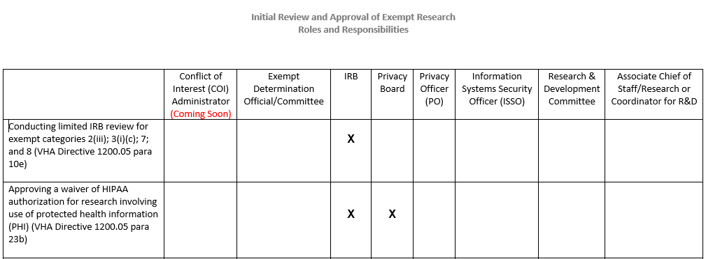
Limited IRB Review and Waiver of HIPAA Authorization

Slide 17
Limited IRB Review
Limited IRB Review is a condition of exemption for the following exempt categories: Exempt category 2(iii); 3(i)(C); 7; and 8.
Limited IRB Review can only be done by an IRB
  Convened board or expedited review procedures can be used for limited IRB review
  The IRB is only required to review and approve the specific conditions specified in the regulations
The IRB does not oversee exempt research even if limited IRB review is a condition of the exemption
Limited IRB Review Worksheet

Slide 18
Exempt Research Involving Protected Health Information
VA approved exempt research involving protected health information (PHI) is not exempt from the Privacy Rule and the Privacy Act
One of the following is required for exempt research that involves accessing or using protected health information:
  Data use agreement for use or disclosure of a limited data set
  Written HIPAA authorization signed by the subject or subject’s personal representative
  A waiver of HIPAA authorization approved by either an IRB or a Privacy Board
Only an IRB or a Privacy Board can approve a waiver of HIPAA authorization
  VA Privacy does not allow alterations of HIPAA

Slide 19
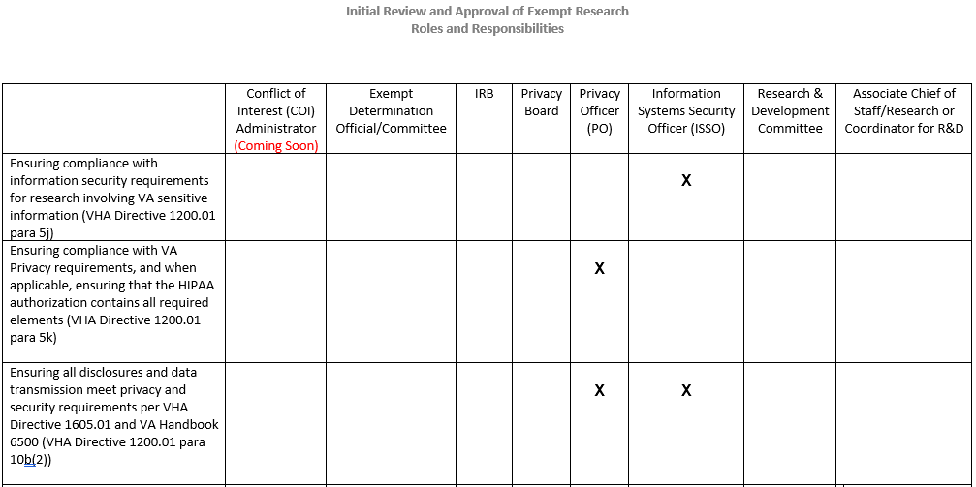
Privacy and Information Security Reviews

Slide 20
R&D Committee Initial Review and Approval of Exempt Research and ACOS/R&D Study Initiation Letter
Roles and Responsibilities Table

Slide 21
R&D Committee Initial Review and Approval of Exempt Research
The R&D Committee can use either designated review or convened board review to approve exempt research
R&D Committee initial review and approval criteria is similar to that of non-Exempt research with the addition of the following:
  VHA Directive 1200.05 para 10c requires that specific information be given to prospective subjects when the exempt research involves the investigator interacting with human subjects or obtaining information by educational tests, survey or interview procedures, or behavioral interventions (see Roles and Responsibilities Table)
  May apply to exempt categories 1, 2, 3, 5 and 6.
A number of tools for R&D Committee initial review and approval were distributed during prior workshops in December 2019 and are available on ORPP&E’s webinar webpage
  https://www.research.va.gov/programs/orppe/education/webinars/archives.cfm

Slide 22
ACOS/R&D Study Initiation Notification
The Associate Chief of Staff for Research and Development (ACOS/R&D) is responsible for notifying investigators in writing when a research project can be initiated, and the period for which the project is approved
Notification occurs only after the research project has been approved by all applicable R&D Committee subcommittees/committees and the R&D Committee
Combined Sample ACOS/R&D and R&D Committee approval/study initiation notice
Reference: VHA Directive 1200.01, Paragraph 5.g.(2)

Slide 23

Closing Thoughts

Slide 24
Contact Information for Panelists
Dawn Biddulph
Program Specialist
R&D/IRB Coordinator
Lexington VA Health Care System
E-mail: Dawn.Biddulph@va.gov
Gregory L. Green, MPH, CIP
HRPP Manager
San Francisco VA Health Care System
E-mail: Gregory.Green@va.gov

Slide 25

Questions

Slide 26
Availability of Recording
A recording of this session and the associated handouts will be available on ORPP&E’s Education and Training website approximately one week post-webinar
An archive of all ORPP&E webinars can be found here: https://www.research.va.gov/programs/orppe/education/webinars/archives.cfm

Slide 27
Research and Development Committee Workshop Series
Proposed Training | Training Type | Tentative Date
Differentiating roles of the R&D Committee and the IRB | Traditional Webinar | 11/7/2019
R&D Committee Responsibility: Review and Approval of Research | Workshop | 12/11/2019
R&D Committee Operations: Convened Meeting vs. Designated Member Review (DMR) | Workshop | 12/19/2019
R&D Committee Responsibility: Part 1- Review and Approval of Exempt Research | Workshop | 2/4/2020
R&D Committee Responsibility: Non-Compliance Review and Reporting | Workshop | 3/4/2020
Review and Approval of Exempt Research: Part 2 - Capstone Case | Workshop | TBD
R&D Committee Responsibility: Review and Approval of Non-Veterans | Workshop | TBD
R&D Committee Responsibility: Reliance on External IRBs and Oversight of Research approved by External IRBs | Workshop | TBD
R&D Committee Responsibility: QI/QA Activities | Workshop | TBD

Slide 28
Important Links
Revised Common Rule (published January 19, 2017)
  Pages 7259 to 7274 contain the Text of the Final Rule
VHA Directive 1200.05
VHA Directive 1200.01
ORD Policies and Guidance Documents
ORPP&E Cyberseminars
ORPP&E’s Single IRB webpage
Coming soon: Information on VAIRRS

